Slide 1
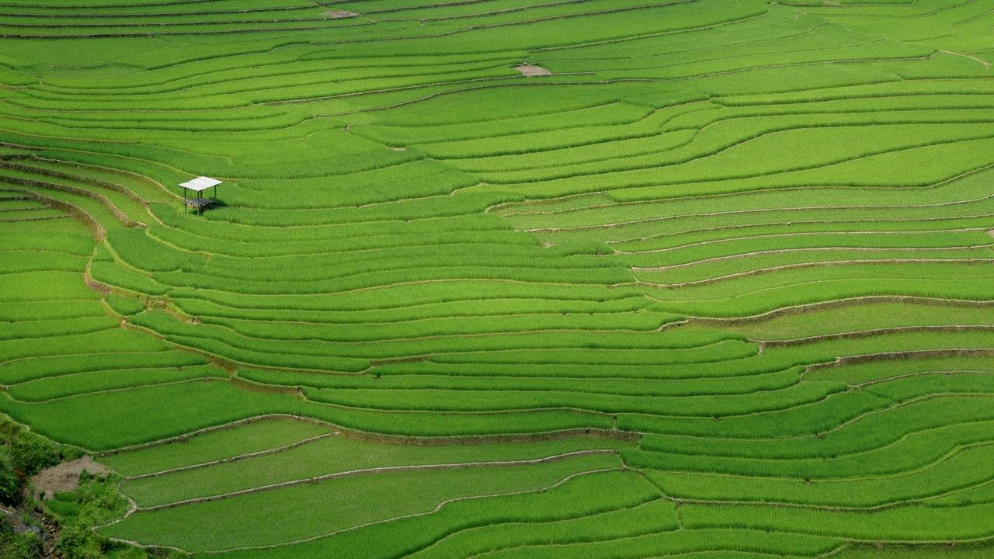

GoogleECOM KHIZAR | IBTISAAM | ATIF

Slide 2

Google Energy Control & Packet Tracing Monitor
Supervised by Dr. Mirza Omer Beg
Khizar Naseer Butt [i15-0024]
Ibtisaam Butt [i15-0027]
Malik Atif Aziz [i15-0057]

Slide 3
4 Billion People Online
1 Zettabytes Data
Waste of Joules & Privacy at Stake!
Project Overview
That’s a lot of people
And a lot of data

Slide 4
Monitoring and Analyzing Mobile Traffic
ISP Traces
GoogleECOM
Network Scale
User Traces
Granularity of Information

Slide 5
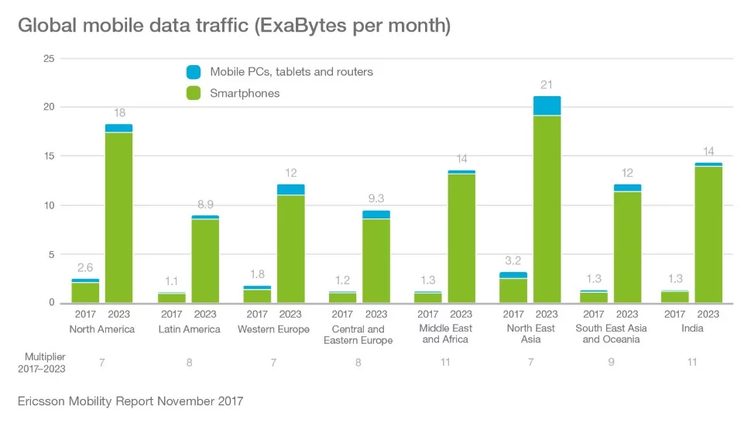

Slide 6
- Protection of information being everyone’s priority! - Risk of information leakage! - Empower people to take control of their data. - Informing users regarding energy consumption. - Why not aid the society by Green Computing?
Motivation

Slide 7
- Energy Carbon Map of Network Usage. - Network Traffic Monitoring. - Real-Time Prevention of Privacy Leaks in Mobile Devices. - Android Application for Visualization of Data. - Calculation of energy consumption in Joules. - Research Paper consisting of our findings.
Expected Outcomes

Slide 8

Research
&
Development

Slide 9
- AntMonitor: A System for Monitoring from Mobile Devices - AntShield: On-Device Detection of Personal Information Exposure - An Analysis of the Privacy and Security Risks of Android VPN Permission-enabled Apps
Literature Review

Slide 10
- Android Application. - Network Packet Tracer. - Personal Identified Information Classifier (CNN). - Energy Calculation Regressor. - Green Computing.
Project Scope/ High Level Features

Slide 11
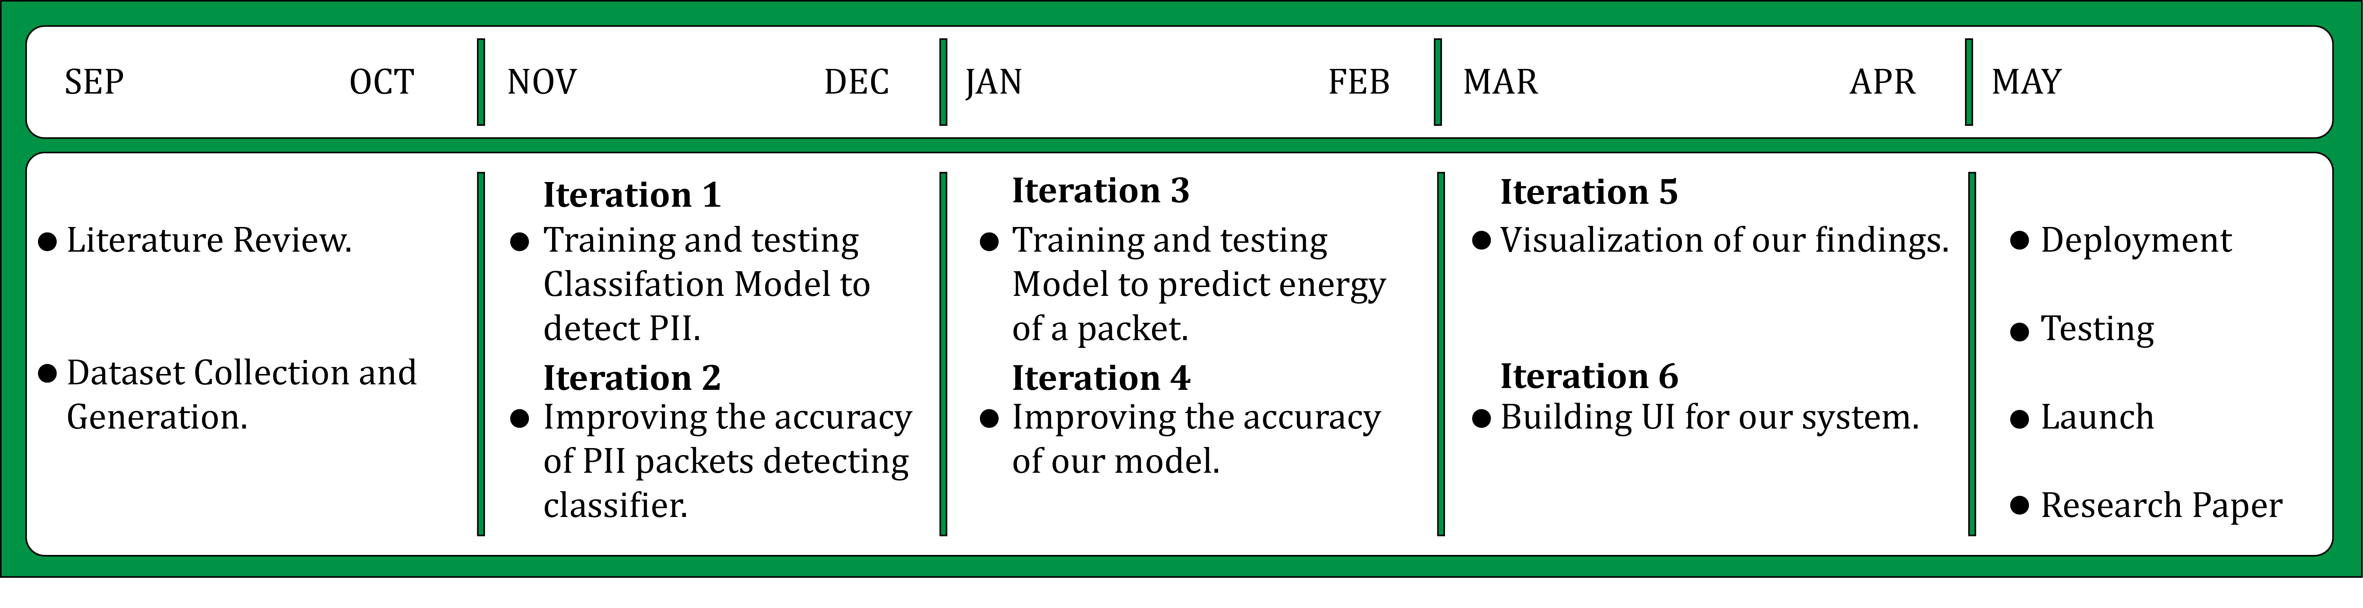
Timeline

Slide 12








Tools /Technologies

Slide 13
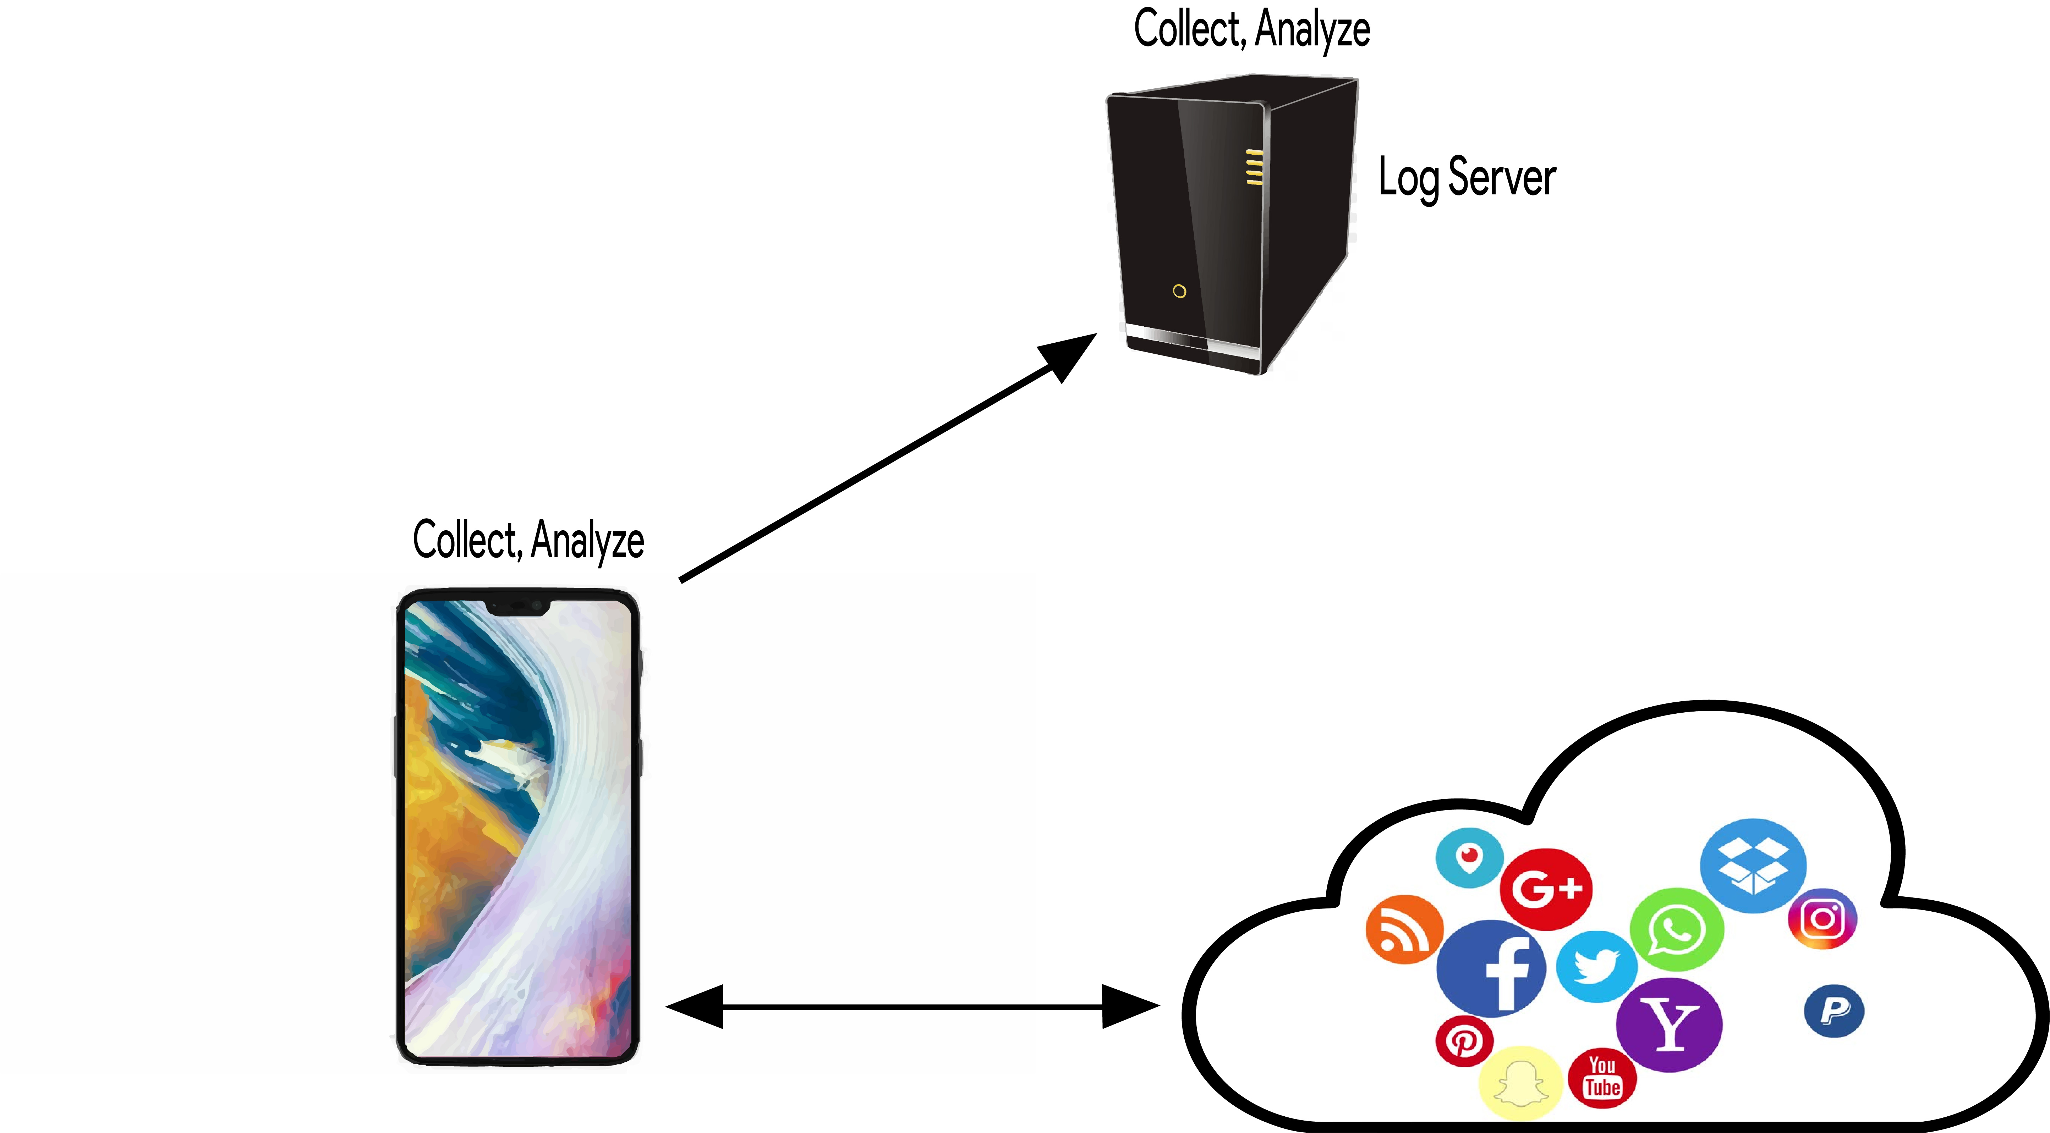
Work Flow

Slide 14
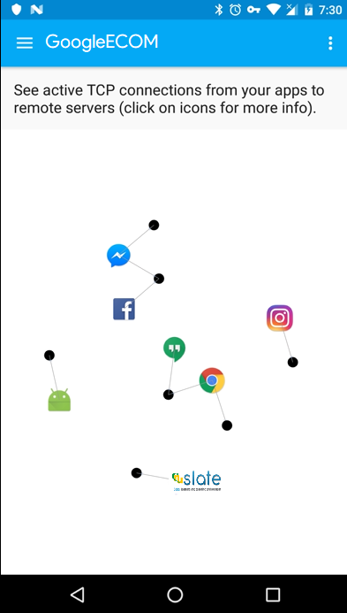
Android Application
Place your screenshot here

Slide 15
Thanks!
ANY QUESTIONS?

